Slide 1



PLAN OF WORK COMPLETION
Phase 1: Planning and Design
Phase 2: Development and Testing
Phase 3: Deployment and Maintenance

Slide 2
MACHINE LEARNING
MODEL
Dataset: Utilized a comprehensive dataset with over 100,000 entries, encompassing diverse market trends and consumer behaviors.
Algorithm: Implemented the Random Forest algorithm due to its robustness and ability to handle large datasets efficiently. This algorithm excels in predicting outcomes by creating multiple decision trees and combining their results for improved accuracy.
Training and Testing: The model was trained and tested on the dataset to ensure high accuracy and reliability in predicting ad campaign strategies.

Slide 3
COMPARISON WITH API RESULTS
Benchmarking: The model's predictions are compared with results from existing marketing APIs to benchmark performance.
Evaluation Metrics: Key metrics such as accuracy, precision, recall, and F1-score are used to evaluate and compare the performance of the model against API results.
Outcome: The comparison ensures that the best possible ad campaign strategy is selected, leveraging both the model's predictions and API insights.

Slide 4
Ad Campaign
Selection
Strategy Optimization: The model analyzes various factors such as market trends, consumer behavior, and past campaign performance to predict the most effective ad campaign strategy.
Decision-Making: By comparing the model's predictions with API results, the system selects the optimal ad campaign strategy that maximizes reach and engagement.
Benefits: This approach enhances the efficiency and effectiveness of marketing efforts, providing marketers with actionable insights and customized strategies

Slide 5
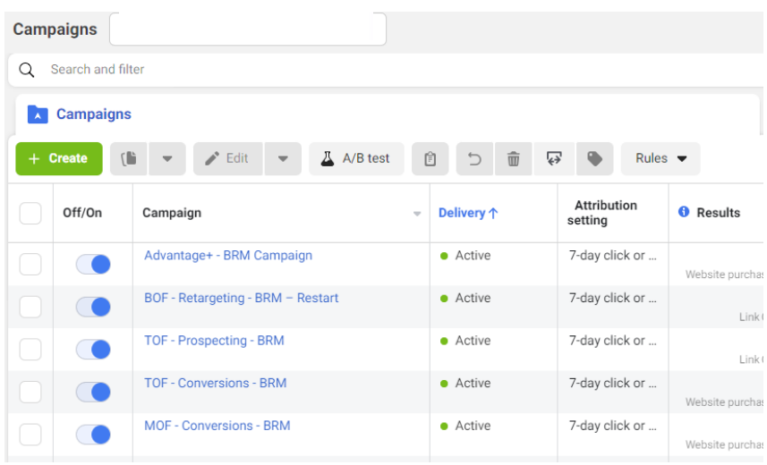
Ad Campaign
CREATION

